Slide 1
Devops

Slide 2
什么是Devops？
DevOps（Development和Operations的组合词）是一种重视“软件开发人员（Dev）”和“IT运维技术人员（Ops）”之间沟通合作的文化、运动或惯例。

Slide 3
Devops=Dev+Ops

Slide 4
Why Devops？

Slide 5
一个小张的例子
大学期间，小张跟老师做一些小项目，开发、测试、部署都是自己一个人搞定。

Slide 6
小张毕业后去公司了，有了开发团队。
部署人员一般都是由开发团队兼任。
因为有了开发团队，所以小张他们采用了瀑布模型进行开发。

Slide 7
后来项目越来越复杂，开发团队无法再兼任测试的任务，公司又添加了测试部门，这个时候再用瀑布模型就会使开发团队和测试团队沟通成本太大，于是小张他们使用敏捷开发进行开发，加快了服务上线的速度。

Slide 8
互联网浪潮来袭后小张他们做了一个互联网软件，但是这个系统可比原来的单机软件要复杂得多，尤其是要面对海量用户的高并发访问，需要解决各种各样的技术难题，挑战巨大。 系统不但复杂，还需要以24*7的方式运行， 靠开发或测试的兼职人员已经无法维护了。这时候公司就引进了运维部门。

Slide 9
小张负责的开发团队向运维提交了一份“完美”的代码。
但是这份开发团队认为“完美”的代码却在运维团队的部署中出现了down机。运维部门的小王就来找小张，说他们的代码有问题。
小张怎么也想不到是这种结果，于是跟小王争论到：“我们在测试的时候的用户压力比实际压力大好多，代码十分完美，肯定是你们运维部门配置错了！”
“不可能，我们是严格按照你们要求的步骤来部署的，肯定是你们代码的问题！”
“那测试环境怎么就没有问题？”

Slide 10
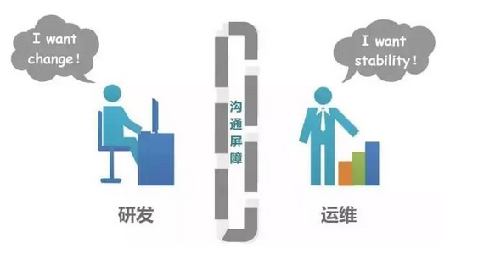
为什么要运用Devops

Slide 12
每次部署都是一整个项目的部署，环境配置很有可能出错
每次开发团队交付代码，都得派人去运维部门进行指导教学
运维部门只想按部就班配置环境，出了错就找开发团队
运维部门与开发部门之间沟通代价巨大

Slide 13
运维部门缺乏对项目的充分认识，开发部门缺乏对生产环境的足够认识，导致代码在开发完毕到上线后要经历一个巨大的鸿沟。

Slide 14
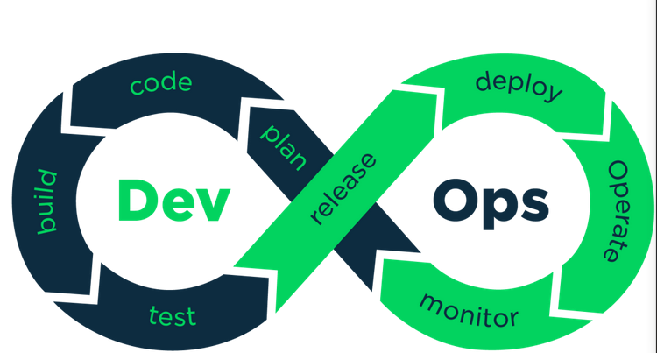
How？

Slide 15
运维人员要了解业务
Code变化带来的影响要告知运维人员
开发人员工作的开发/测试环境要尽可能地和生产环境一致
以微服务为单位进行部署，实现频繁部署的可能
开发和运维团队合作，实现自动化部署

Slide 16
最终目的
减少需求从提出到上线，交付给用户使用的时间

Slide 17
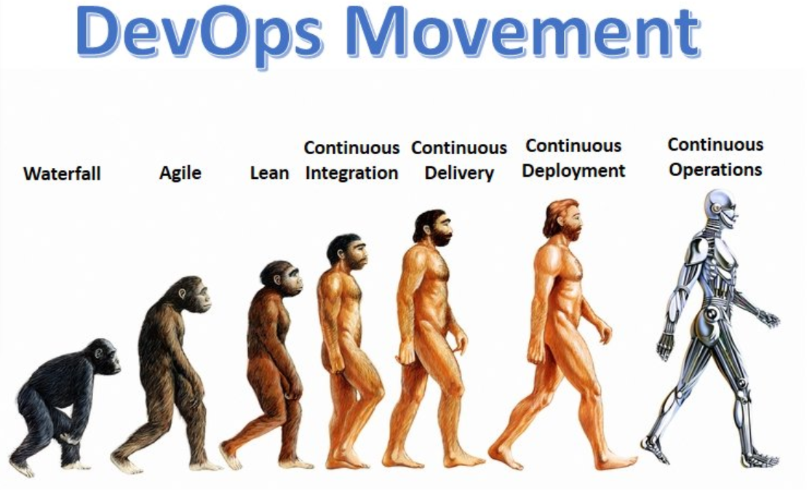
程序和服务越来越复杂

Slide 18
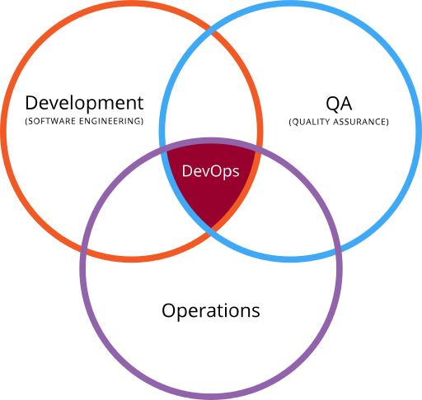
简介
DevOps（英文Development和Operations的组合）是一组过程、方法与系统的统称，用于促进开发（应用程序/软件工程）、技术运营和质量保障（QA）部门之间的沟通、协作与整合。它的出现是由于软件行业日益清晰地认识到：为了按时交付软件产品和服务，开发和运营工作必须紧密合作。
DevOps (a clipped compound of "development" and "operations") is a software engineering practice that aims at unifying software development (Dev) and software operation (Ops). The main characteristic of the DevOps movement is to strongly advocate automation and monitoring at all steps of software construction, from integration, testing, releasing to deployment and infrastructure management. DevOps aims at shorter development cycles, increased deployment frequency, more dependable releases, in close alignment with business objectives.
Notes:
DevOps是一个旨在统一软件开发和软件运维的软件工程实践。DevOps的主要特点是在软件构建的所有步骤（从集成、测试、发布到部署和基础架构管理）中大力倡导自动化和监控。DevOps的目标是缩短开发周期，提高部署频率，更可靠的发布，并且与业务目标保持一致

Slide 19
传统软件组织
传统的软件组织将开发、IT运营和质量保障设为各自分离的部门。在这种环境下如何采用新的开发方法（例如敏捷开发），这是一个重要的课题：按照从前的工作方式，开发和部署不需要IT支持或者QA深入的、跨部门的支持，而却需要极其紧密的多部门协作。
如果一个组织要生产面向多种用户、具备多样功能的应用程序，其部署周期必然会很短。这种能力也被称为持续部署，并且经常与精益创业方法联系起来。

Slide 20
精益创业
精益创业来源于互联网行业，是软件开发的一种新模式。但其背后的“客户验证”思想在大量非IT领域得到应用。例如美剧的拍摄，往往都会先拍摄一部几十分钟的先导片，交代主要的人物关系、矛盾冲突、故事背景，然后邀请几十位观众参加小规模试映会，再根据观众的反馈来决定剧情要作那些修改，是否需要调整演员，以及决定是否投拍。在每一季结束时，制作方又会根据收视率和观众意见，决策是砍掉该剧还是订购新一季内容。这种周拍季播的模式，把所有的决策权交给观众，让制作方的投资以及失败成本降到了最低，是一种典型的精益创业方式。

Slide 21
出现原因
DevOps的引入能对产品交付、测试、功能开发和维护（包括──曾经罕见但如今已屡见不鲜的──“热补丁”）起到意义深远的影响。在缺乏DevOps能力的组织中，开发与运营之间存在着信息“鸿沟”──例如运营人员要求更好的可靠性和安全性，开发人员则希望基础设施响应更快，而业务用户的需求则是更快地将更多的特性发布给最终用户使用。这种信息鸿沟就是最常出问题的地方。
以下几方面因素可能促使一个组织引入DevOps：
使用敏捷或其他软件开发过程与方法
业务负责人要求加快产品交付的速率
虚拟化和云计算基础设施日益普遍
数据中心自动化技术和配置管理工具的普及

Slide 22
对应用程序发布的影响
在很多企业中，应用程序发布是一项涉及多个团队、压力很大、风险很高的活动。然而在具备DevOps能力的组织中，应用程序发布的风险很低，原因如下：
与传统开发方法那种大规模的、不频繁的发布（通常以“季度”或“年”为单位）相比，敏捷方法大大提升了发布频率（通常以“天”或“周”为单位）
减少变更范围，与传统的瀑布式开发模型相比，采用敏捷或迭代式开发意味着更频繁的发布、每次发布包含的变化更少。由于部署经常进行，因此每次部署不会对生产系统造成巨大影响，应用程序会以平滑的速率逐渐生长。加强发布协调，靠强有力的发布协调人来弥合开发与运营之间的技能鸿沟和沟通鸿沟；采用电子数据表、电话会议、即时消息、企业门户（wiki、sharepoint）等协作工具来确保所有相关人员理解变更的内容并全力合作。自动化强大的部署自动化手段确保部署任务的可重复性、减少部署出错的可能性。

Slide 23
协调人
协调人是企业级IT组织中一个新出现的角色，其主要任务就是协调安排将企业级软件部署到预生产环境。对发布协调人的需求来自于以下几方面原因：
需要弥合开发与运营的鸿沟
基础设施日益变得复杂：为了运营web应用，需要多层基础设施和多种平台
发布频率上升（由于敏捷和迭代式开发的引入）
分布式团队：位于全球多个地点的、包含外包人员的、混合开发/测试/基础设施的团队

Slide 24
DevOps基本原则
基础架构即代码
持续交付
协作
Next

Slide 25
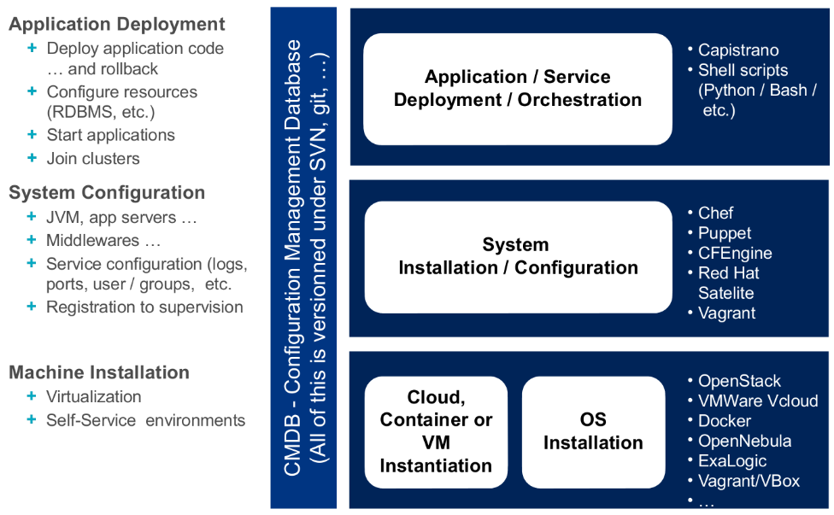
基础架构即代码
基础架构即代码（IaC）是大部分通用DevOps实践的前提要求，例如版本控制、代码审阅、持续集成、自动化测试。这一概念涉及计算基础架构（容器、虚拟机、物理机、软件安装等）的管理和供应，以及通过机器可处理的定义文件或脚本对其进行的配置，交互式配置工具和手工命令的使用已经不合时宜了。
Back

Slide 26
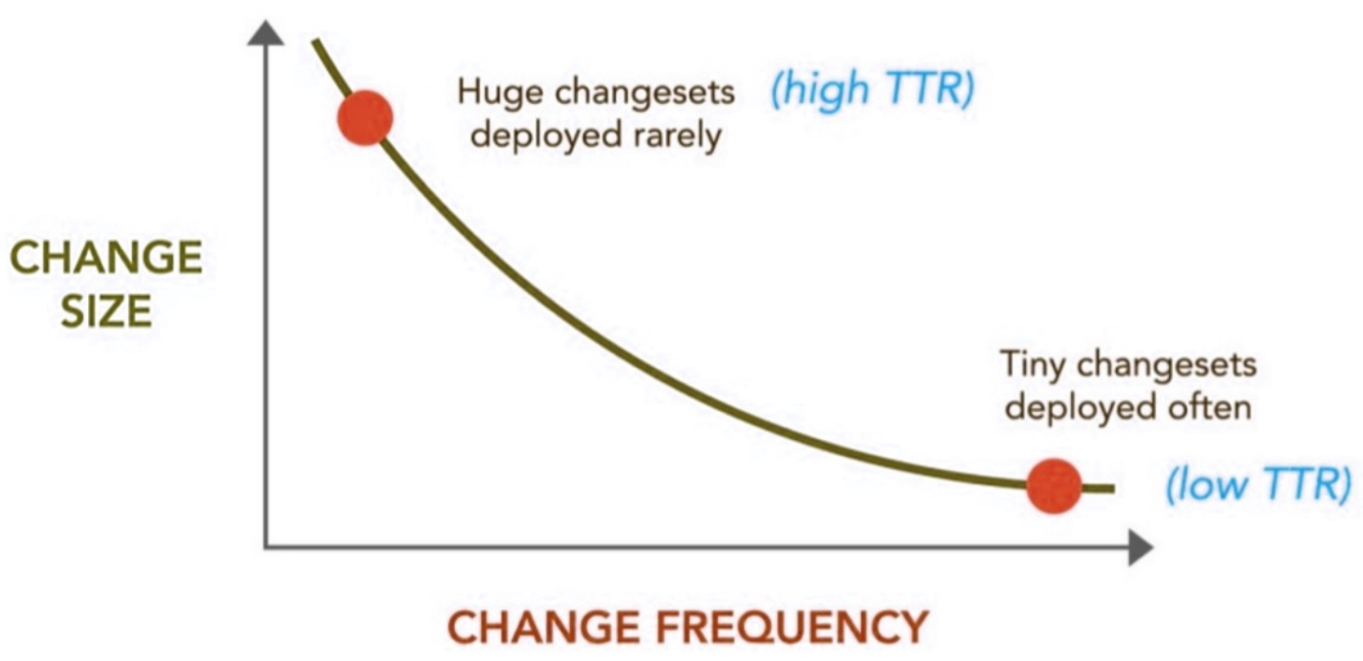
持续交付
持续交付是一种可以帮助团队以更短的周期交付软件的方法，该方法确保了团队可以在任何时间发布出可靠的软件。该方法意在以更快速度更高频率进行软件的构建、测试和发布。
通过对生产环境中的应用程序进行更高频次的增量更新，这种方法有助于降低交付变更过程中涉及的成本、时间和风险。足够简单直接并且可重复的部署流程对持续交付而言至关重要。
持续交付的主要想法：
部署越频繁，对部署流程就会越熟悉，自动化机制就能获得更好的结果
部署越频繁，所部署的变更集就越微不足道
部署越频繁，TTR（修复／解决所需时间）指标就会越出色
Back

Slide 27
协作
敏捷软件开发破除了需求分析、测试和开发之间的一些隔阂。部署、运维和维护等其他活动与软件开发过程中的其他环节也存在类似的分隔。DevOps方法意在破除所有这些隔阂，鼓励开发和运维人员之间的协作。
DevOps文化的主要特征在于开发和运维角色之间日益增加的协作。这是一种在团队内部以及组织层面上很重要的文化变迁，通过这样的变迁才能促进更好的协作。
团队合作对DevOps是如此的重要，大部分方法论所要实现的最终目标总的来说可以通过两个C来实现：协作（Collaboration）和沟通（Communication）。虽然单纯做到这些距离真正的DevOps工作环境还有很大的差距，但任何公司只要能坚持这两个C，就等于迈出了最正确的第一步。
Back

Slide 28
实施障碍
将技术置于人之前
实施DevOps的核心目的是消除开发者和IT操作人员之间的障碍。企业在实施DevOps时会犯的一个常见错误是太早、太频繁的关注在技术上，而不是人员和流程上。
忽视安全和管理
实施DevOps时的另一个常见错误就是没有将安全性和管理以全面系统地方式考虑进你的应用里。现如今你不再能将安全性从应用程序中隔离开来。在每一个流程中都需要包含对安全性的考量，包括持续测试和持续部署。
不愿作出改变
DevOps实施意味着需要一直质疑你开发、测试、部署和运行应用的方式。流程，技术和工具都需要改变，组织应该收集各种指标，以确定所做的变更是否真的提高了生产率。DevOps需要改变和发展以跟上新兴的理念和技术。在设计你的DevOps流程时始终要将变化考虑在内.

Slide 29
一些Devops的工具
开发类的DevOps工具
版本控制和协作，例如Git、SVN等；
构建和测试自动化，例如Ant、Selenium、Jmeter等；
持续集成和交付，例如Jenkins（开源持续集成组件）、CruiseControl等；

Slide 30
部署类的DevOps工具
容器平台，例如Docker（开源容器组件）等；
配置管理，例如Chef、Puppet、Ansible等；
微服务平台，例如Cloud Foundry、Kubernetes（开源产品化容器编排平台）等；
服务开通，例如Puppet、Docker Swarm、Vagrant等；

Slide 31
维护类的DevOps工具
日志，例如logstash等；
监控告警和分析，例如Nagios、Zabbix（开源自动化监控组件）、Kibana等；

Slide 32
Docker 使用Docker——以容器化的方式去部署应用，进行持续集成。Docker像集装箱一样，打包了所有依赖，再在其它服务器上部署很容易，不至于换服务器后发现各种配置文件散乱放置，这样就解决了编译时依赖和运行时依赖的问题。Docker简化了配置管理，提升了可操控性，并让横向扩展变得简单。Docker还能让容器在不同的位置自由地移动。

Slide 33
Git Git平台有助于开发者们在上面进行协作，进行统一的代码管理，如代码仓库、代码拉取等等。与GitHub的集成十分容易，几乎任何系统都可以连接到GitHub上，没有什么特殊限制。GitHub也可以放置个人信息和项目相关的数据。它支持本地分支、过度区域和多工作流。

Slide 34
什么是DevOps
DevOps is the practice of operations and development engineers participating together in the entire service lifecycle, from design through the development process to production support.
DevOps is also characterized by operations staff making use many of the same techniques as developers for their systems work.

Slide 35
5 Levels Agile VS. DevOps
Agile Values
-Philosophy, Agile Manifesto
Agile Principles
-Strategic approaches (Welcome changing, etc.)
Agile Methods
-Specific process implementation , e.g., XP,Scrum, etc.
Agile Practices
-highly specific tactical techniques, e.g.,standups, planning poker, backlogs, ci, etc.
Agile Tools
-Specific technical implementations, e.g., JIRA, Version one, etc.
DevOps Values
-working software->service or delivered software
DevOps Principles
widening of Agile’s principles to include systems and operations, e.g., Infrastructure is code
DevOps Methods
-same as agile, except for several distinct methods, e.g., Visible Ops-style change control
DevOps Practices
-CD, toolchain, virtualization and cloud computing , metrics and monitoring schemes,
DevOps Tools
-Explosion of tools, e.g., jenkins, travis, teamcity, ansible, mesos, OpenStack, docker,
Notes:
DevOps Tools DevOps tools consist of configuration management, test and build systems, application deployment, version control and monitoring tools.

Slide 36
DevOps 关键术语 （1）
持续集成（ Continuous Integration, CI）
is a development practice that requires developers to integrate code into a shared repository several times a day. Each check-in is then verified by an automated build, allowing teams to detect problems early.
持续交付（ Continuous Delivery ,CD）
is a set of processes and practices that radically removes waste from your software production process, enables faster delivery of high-quality functionality and sets up a rapid and effective feedback loop between your business and your users
持续部署（Continuous Deployment, CD ）
means that you actually deploy and expose the change to the user immediately.
Notes:
Continuous deployment means that every change is automatically deployed to production. Continuous delivery means that the team ensures every change can be deployed to production but may choose not to do it, usually due to business reasons. In order to do continuous deployment one must be doing continuous delivery.

Slide 37
DevOps 关键术语 （2）
Software as a Service (SaaS)
is a software licensing and delivery model in which software is licensed on a subscription basis and is centrally hosted.
Infrastructure as a Service (IaaS)
Cloud-hosted virtualized machines usually billed on a “pay as you go” basis. Users have full control of the machines but need to install and configure any required middleware and applications themselves.
Platform as a service (PaaS)
PaaS vendors offer a development environment to application developers. The provider typically develops toolkit and standards for development and channels for distribution and payment.

Slide 38
DevOps 关键术语 （3）
Metrics
Deployment frequency
how often does your organization deploy code?
Lead time for changes
how long does it take to go from code commit to code successfully running in production?
Mean time to recover (MTTR)
how long does it generally take to restore service when a service incident occurs
Change failure rate
what percentage of the changes either result in degraded service or subsequently require remediation?

Slide 39
DevOps 关键术语 （4）
Pipeline
to get application from concept to production, engineers all work through steps that become sequential and eventually routine.
Pipeline Orchestration
Tools or products that enable the various automated tasks that make up a Continuous Delivery pipeline to be invoked at the right time. They generally also record the state and output of each of those tasks and visualize the flow of features through the pipeline.

Slide 40
DevOps 关键术语 （5）
Container
Containers provide a lightweight alternative to virtual machines and they enable developers to work with identical DEV environments and stacks. They also facilitate DevOps by encouraging the use of stateless designs.
Docker
Docker is an open-source project that automates the deployment of Linux applications inside software containers. Quote of features from Docker web pages:
Docker containers wrap up a piece of software in a complete filesystem that contains everything it needs to run: code, runtime, system tools, system libraries – anything you can install on a server. This guarantees that it will always run the same, regardless of the environment it is running in.

Slide 41
DevOps 关键术语 （6）
microservices
The term "Microservice Architecture" has sprung up over the last few years to describe a particular way of designing software applications as suites of independently deployable services. While there is no precise definition of this architectural style, there are certain common characteristics around organization around business capability, automated deployment, intelligence in the endpoints, and decentralized control of languages and data.
Notes:
Microservices are a more concrete and modern interpretation of service-oriented architectures (SOA) used to build distributed software systems. Like in SOA, services in a microservice architecture (MSA) are processes that communicate with each other over the network in order to fulfill a goal. Also, like in SOA, these services use technology-agnostic protocols. Microservices architectural style is a first realisation of SOA that has happened after the introduction of DevOps and this is becoming the standard for building continuously deployed systems.

Slide 42
DevOps 关键术语 （7）
GIT
Git is a distributed revision control system with an emphasis on speed, data integrity, and support for distributed, non-linear workflows. Git was initially designed and developed by Linus Torvalds for Linux kernel development in 2005, and has since become the most widely adopted version control system for software development.
Github
GitHub is a web-based Git repository hosting service, which offers all of the distributed revision control and source code management (SCM) functionality of Git as well as adding its own features. Unlike Git, which is strictly a command-line tool, GitHub provides a web-based graphical interface and desktop as well as mobile integration.
Notes:
Microservices are a more concrete and modern interpretation of service-oriented architectures (SOA) used to build distributed software systems. Like in SOA, services in a microservice architecture (MSA) are processes that communicate with each other over the network in order to fulfill a goal. Also, like in SOA, these services use technology-agnostic protocols. Microservices architectural style is a first realisation of SOA that has happened after the introduction of DevOps and this is becoming the standard for building continuously deployed systems.

Slide 43
DevOps 关键术语 （8）
A/B Testing
A technique in which a new feature, or different variants of a feature, are made available to different sets of users and evaluated by comparing metrics and user behavior.
Notes:
Microservices are a more concrete and modern interpretation of service-oriented architectures (SOA) used to build distributed software systems. Like in SOA, services in a microservice architecture (MSA) are processes that communicate with each other over the network in order to fulfill a goal. Also, like in SOA, these services use technology-agnostic protocols. Microservices architectural style is a first realisation of SOA that has happened after the introduction of DevOps and this is becoming the standard for building continuously deployed systems.

Slide 44
AWS是如何去开展DevOps

Slide 46
公司DevOps实施方案

Slide 47
Reading List on DevOps
“The Phoenix Project”, Gene Kim, George Spafford, Kevin Behr
“Continuous Delivery”, Jez Humble and David Farley
“Release It!”, Michael Nygard
“Lean Software Development”, Mary and Tom Poppendieck
“2014 State of DevOps Report,” Jez Humble, Nigel Kersten, Gene Kim, and Nicole Forsgren Velasquez,
“2015 State of DevOps Report” puppet labs, IT Revolution
“2016 State of DevOps Report”
“2017 State of DevOps Report”

Slide 48
Thanks

